Slide 1
Approaches to learning
Learning, Teaching & Assessment
Module 401
Postgraduate Certificate
in Learning and Teaching
in Higher Education

Slide 2
Aims
Provide some evidence that teaching approach influences learning approach
With variable learning/assessment effects
Overview of ideas about learning
Provide a basis for further reading
One starting point for critical reflection on practice
Needed in assignments!
Note – there are a lot of theories about learning!

Slide 3
Some opening thoughts
Learning is not an agreed, nailed down phenomenon (like teaching)
gathering evidence is often complex and contested
People usually have ideas about learning that may not be articulated (like teaching)
Theories (or models) about learning contain concepts/beliefs
The current dominant models (in the west) are individualistic and cognitive

Slide 4
Definition - Learning
Learning is a process, not a product
Learning is a change in knowledge, beliefs, behaviours or attitudes Takes time; especially with changes to core beliefs, behaviours, and attitudes
Learning is not something done to students, but something that students themselves do
University of Pittsburgh
Agreement that it is an active process
– and teaching needs to support active engagement
Constructivist
Learners make their own meaning
Notes:
Note emphasis on behaviour in first definition
a complex process, involving“…internal and socially constructed processes mediated by affect and motivation (McAlpine, 2004 p119)
McAlpine, L. (2004) Designing learning as well as teaching: A research based model for instruction that emphasizes learner practice. Active Learning in Higher Education. Vol 5 (2), p119-134
“learning is not what you do to the students, learning is what the students do themselves” (Bates et al, 2010)
I. Bates, D. Baume and S. Assinder (2010) Focusing on student learning to guide the use of staff time Innovations in Education and Teaching International 47:357–367

Slide 5
Learning as a process
Learning as a quantitative increase in knowledge. Learning is acquiring information or ‘knowing a lot’.
Learning as memorising. Learning is storing information that can be reproduced.
Learning as acquiring facts, skills, and methods that can be retained and used as necessary.
__________________________________________________________________
Learning as making sense or abstracting meaning. Learning involves relating parts of the subject matter to each other and to the real world.
Learning as interpreting and understanding reality in a different way. Learning involves comprehending the world by reinterpreting knowledge.
Note ‘possession’, unchanged
Note ‘the personal’, change
Differences between 1-3 & 4-5
(Saljo quoted in Ramsden 1992)
Notes:
As Paul Ramsden comments, we can see immediately that conceptions 4 and 5 in are qualitatively different from the first three. Conceptions 1 to 3 imply a less complex view of learning. Learning is something external to the learner. It may even be something that just happens or is done to you by teachers (as in conception 1). In a way learning becomes a bit like shopping. People go out and buy knowledge - it becomes their possession. The last two conceptions look to the 'internal' or personal aspect of learning. Learning is seen as something that you do in order to understand the real world.
http://www.infed.org/biblio/b-learn.htm

Slide 6
Teaching and learning
Teachers adopt qualitatively different approaches to teaching
Does this
affect
learning?

Slide 7
A CCSF (student centred) approach includes elements of an ITTF (teacher centred) approach, but not vice versa
Arguing for a wide repertoire with the capacity to adjust to context
and always with a focus on learning
CCSF - Conceptual Change/Student-focused
ITTF - Information Transmission/Teacher-focused
Prosser & Trigwell

Slide 8
It’s All about Learning
Success of a lecture is determined by what has been learnt – not by lecturer performance
“what the student does is more important in determining what is learnt than what the teacher does” (Sheull; in Fry et al).
Do we plan for learning or delivery?
"The secret of teaching is to appear to have known all your life
what you learned this afternoon." - Anonymous

Slide 9
Three models of learning
From the Carlile & Jordan article
Behaviourism
Cognitivism
Constructivism
In pairs
identify the key points of theory
Identify the key implications for practice
Explain to the ‘table’
Evaluate your own practice
Keep notes for reflective assignment

Slide 10
Psychological theories Led to these types of questions:
What can we discover about how individuals learn?
What are the implications of our knowledge about individual learning for classroom teaching and curriculum design?
What is going on outside the classroom which might impact upon learning outcomes?
Largely survey research about students

Slide 11
Approaches to learning
Aimed to understand individual students' own perspectives of the situation
Rather than aiming for the perspective of an "objective" outside observer. analysed participants' approach to reading task
Marton and Säljö (1976)
Dominant ‘approach’ in L&T research

Slide 12
Deep & Surface
Identified two distinctly different approaches – deep and surface
Later a third – strategic
These terms have entered the discourse of HE
Note still largely focussed on the individual

Slide 13
Deep, surface and strategic - approaches to learning
NB these are Approaches only – not fixed but influenced by initial student orientation & teacher/programme orientation
Surface
– aim to reproduce, often unconnected facts
Deep
– aim is to make sense of learning, connections
Strategic
– aim is to pass, what does lecturer want? skilful use of surface approach, deep if needed, influenced by context
See Gibbs – summary article on impacts of approaches to learning on outcomes
and effects of programmes on approaches to learning
Notes:
Gibbs
Kember, Leung
Biggs
NB definitely times for strategic learning

Slide 14
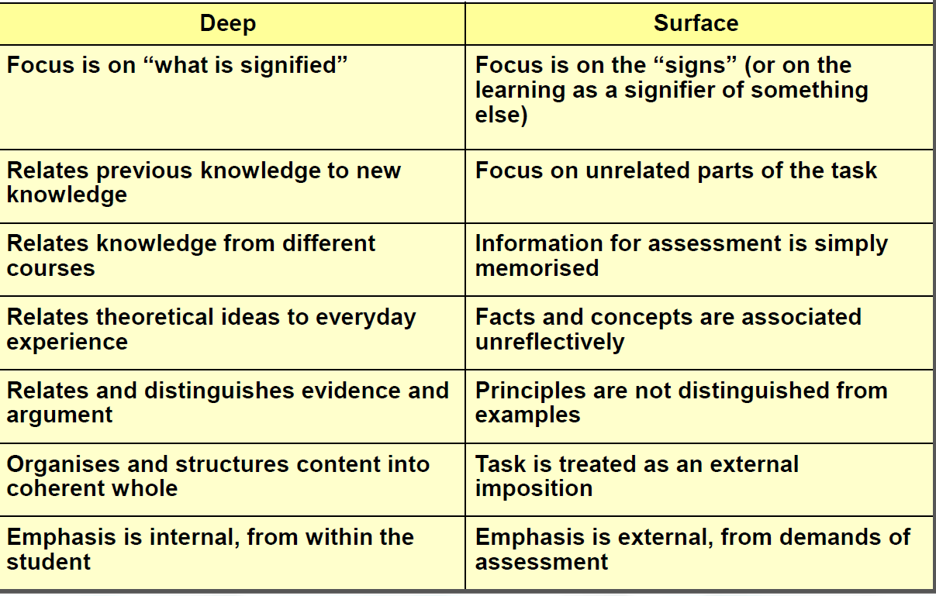
Deep Surface
Approaches to Learning
Adapted from Ramsden 1988; J. Pritchard, Bristol University

Slide 15
 | Surface | Deep | Achieving (strategic)
Motive | fear of failure | intrinsic interest | achievement
Strategy | narrow target, rote learn | maximize meaning | effective use of space and time
The original Learning Process Questionnaire: Dimensions, motives and strategies
In Kember et al 2004

Slide 16
Studies show: Course characteristics associated with surface learning
Heavy workload
Relatively high class contact hours
An excessive amount of course material
A lack of opportunity to peruse a subject in depth
A lack of choice over subjects and over method of study
A threatening and anxiety provoking assessment system Gibbs 2002 p6
Of course there are other factors; note it says associated

Slide 17
Own course and approaches to learning
Discussion
How does your course fare on the deep/surface approach?
Anything you could do to change any aspect?
This discussion can be part of reflection on practice for assignment
Notes:
Gibbs

Slide 18
Critique of Approaches to Learning
Any theory (wrt learning) highlights some aspects disregards others
Approaches focuses on cognitive aspects
Insufficient attention to social and cultural factors in supporting/hindering learning
How does the broader context affect learning?

Slide 19
Alienation and Engagement
Learning hindered by disconnection/no sense of belonging
Classmates, Teachers, Programme, Department, University, Career
What relationships exist (or not)?
How well ‘connected’ are your students to your programme?
Evidence?
How might you enhance?
Case 2008
Notes:
Oxford English Dictionary (in Case 2008) definition of alienation:
‘‘the state or experience of being isolated from a group or an activity to which one should belong or in which one
should be involved’’.
NB MO’B WP Study

Slide 20
Alienation and Engagement
Increasing evidence that engagement fosters learning (achievement)
Linkage not strong, many factors at work
(Carini et al 2006)
Increasing use of National Survey of Student Engagement (NSSE)
In USA & Australia, pilot in UK
Focuses on what students do and on relationships (to class etc)
i.e. includes ‘social’ influences on learning
What about your students: say P/T, at home, international
Notes:
Student Engagement and Student Learning: Testing the Linkages 2006
Robert M. Carini, George D. Kuh, and Stephen P. Klein

Slide 21
Student engagement
students’ cognitive investment, emotional commitment and active participation in learning (Chapman 2003)
“students’ involvement with activities and conditions likely to generate high quality learning” (ACER 2008)
Proposal 4: Create learning that is active, collaborative and fosters learning relationships
(In Zepke & Leach 2010)
Notes:
a far reaching construct:
Gaining interest in UK; well used in USA and Australia
ACER = The Australian Council of Educational Research
2010 11: 167 Active Learning in Higher Education Nick Zepke and Linda Leach Improving student engagement: Ten proposals for action
See Handout for full list of 10
Table 1. A conceptual organizer for student engagement
Research perspectives Proposals for action
Motivation and agency
(Engaged students are intrinsically motivated and want to exercise their agency)
1. Enhance students’ self-belief
2. Enable students to work autonomously, enjoy learning relationships with others and feel they are competent to achieve their own objectives
Transactional engagement
(Students and teachers engage with each other)
3. Recognize that teaching and teachers are central to engagement
4. Create learning that is active, collaborative and fosters learning relationships
5. Create educational experiences for students that are challenging, enriching and extend their academic abilities
Institutional support
(Institutions provide an environment conducive to learning)
6. Ensure institutional cultures are welcoming to students from diverse backgrounds
7. Invest in a variety of support services
8. Adapt to changing student expectations
Active citizenship
(Students and institutions work together to enable challenges to social beliefs and practices) 9. Enable students to become active citizens
10. Enable students to develop their social and cultural capital

Slide 22
Social Constructivism
Dialogue and communication key to constructing meaning
Involves others
So: group work, collaborative learning, peer learning, PBL, discussion
Model desired practice, build trust, use interpersonal skills
Zone of Proximal Development
Learning at the next level
‘Scaffolding’ (providing supports) so learners can move to next level
mentoring, structuring (and removing structure) so learners become more independent
Do you demonstrate these?
How, evidence?
Carlile and Jordan (2005)

Slide 23
Next:
Other models
Active learning
In practice

Slide 24
Kolb’s experiential learning cycle
Learning is founded in experience
Learning moves through a 4 stage cycle and repeats
Experience (either in class or outside)
Review experience
Draw conclusions
Plan for next (similar) experience
Key model, leads to: one version of learning styles, reflective questioning process, PBL, Race’s model

Slide 25
Experiential learning in practice
Start with an activity
practical, discussion, case study, own experiences, question, problem
PBL, inquiry based learning, clinical placements, tutorials (run ‘properly’)
Review, gather data, responses
Reflective journals on placements
Link to theory (from lecture or reading), generate patterns, derive understanding
Work out implications for next time
How can this be used, applied
Do you demonstrate these?
How, evidence?

Slide 26
Race’s model key factors underpinning successful learning
Building on Kolb
Wanting – motivation: interest, enthusiasm and /or
Needing - motivation: necessity, completion
Doing – practice, trial and error
Feedback – getting reactions: self, peers, tutors
Digesting – reflection, making sense, owning the learning
How would you rate your courses/teaching on these?
Which get the highly rated time (i.e. your time)?
Do you demonstrate these?
How, evidence?
Notes:
Everyday language – useful tool to analyse own work

Slide 27
Active learning
is generally defined as any instructional method that engages students in the learning process ... in practice active learning refers to activities that are introduced into the classroom
Students will remember more content if brief activities are introduced to the lecture. Contrast this to the prevalent content tyranny that encourages faculty to push through as much material as possible in a given session.
The best available evidence suggests that faculty should structure their courses to promote collaborative and cooperative environments
Prince 2004
Notes:
In short, active learning requires students to do meaningful learning activities and think about
what they are doing . While this definition could include traditional
activities such as homework,

Slide 28
Making lectures more interactive
A student’s informed view and an academic’s implementation
Look at the Morrow & Friel article
Analyse it for application in your area
Can you do something like this is your classes?
If so: what, how, challenges, solutions
An option for L&T reflection assignment
Notes:
Handout!

Slide 29
Turning theory into practice
Use the ‘theory into practice’ summary to evaluate your programme/your teaching
In what ways does your teaching practice reflect all or parts of these models of learning?
Behaviourism, Cognitive, Constructivism, Social constructivism, Kolb, Race
Knowledge of theory is useful for providing evidence to support changes to practice
Knowledge of theory is essential for M level assignments (reflection on practice)!
Fry et al (2007)

Slide 30
A case study: Improved learning in a large enrolment physics class
Compared learning achieved using two different instructional approaches
Measured learning of a specific set of topics and objectives
3 hours of traditional lecture; experienced highly rated instructor
3 hours of instruction; trained but inexperienced instructor using instruction based on research in cognitive psychology and physics education.
Comparison between two large sections (N = 267 and N = 271) of an introductory undergraduate physics course
Found increased student attendance, higher engagement, and more than twice the learning in the section taught using research-based instruction

Slide 31
The research based ‘instruction’
Pre-class reading assignments, pre-class reading quizzes, in-class clicker questions, student-student discussion, small-group active learning tasks, and targeted in-class instructor feedback
Before each of the three 50-min classes, students were assigned a three- or four-page reading, and they completed a short true/false online quiz on the reading
To avoid student resistance, at the beginning of the first class, several minutes were used to explain to students why the material was being taught this way and how research showed that this approach would increase their learning
Deslauriers, Schelew, Wieman 2011

Slide 32
Good teaching
Is making most students use the higher level cognitive processes that the more academic students use spontaneously
https://www.youtube.com/watch?v=w6rx-GBBwVg
But see https://www.youtube.com/watch?v=iMZA80XpP6Y first

Slide 33
Bibliography
Biggs J (2003) Teaching for quality learning at university
Bloom’s taxonomy http://www.ntlf.com/html/lib/suppmat/84taxonomy.htm
Carini et al 2006 Student Engagement and Student Learning: Testing the Linkages 2006
Faculty Development Associates - http://www.developfaculty.com/online/index.html
Fry et al (2003) Handbook for teaching and learning in Higher Education: Enhancing academic practice
Carlile, O. and Jordan, A. (2005) It works in practice but will it work in theory? The theoretical underpinnings of pedagogy
http://www.aishe.org/readings/2005-1/collection.pdf
Deslauriers, Schelew & Wieman (2011) Improved Learning in a Large-Enrollment
Physics Class
Murphy E (1997) Constructivism: From Philosophy to practice http://www.stemnet.nf.ca/%7Eelmurphy/emurphy/cle.html
Thanks to Dr Jane Pritchard, University of Bristol

Slide 34
Bibliography
Kember, Biggs and Leung (2004). Examining the multidimensionality of approaches to learning through the development of a revised version of the Learning Process Questionnaire
Morrow, L. & Friel, N. (n.d.) Making lectures more interactive – a student’s informed view and an academic’s implementation http://www.gla.ac.uk/media/media_148140_en.pdf
Prince 2004 Does active learning work- A review of the research
Prosser M and Trigwell K (1999). Understanding learning and teaching: The experience in HE
Ramsden, P. (1992) Learning to Teach in Higher Education
Smith, M. (2003) Learning theory http://www.infed.org/biblio/b-learn.htm
TLRP Effective learning and teaching in UK higher education HEA.pdf
Trigwell , K. (2006) Presentation at Lancaster University
Trigwell, Prosser & Waterhouse (1999) Relations between teachers’ approaches to teaching and students’ approaches to learning. Higher Education 37 p57=70
University of Pittsburgh http://www.cidde.pitt.edu/ta-handbook/teaching-and-learning-principles/definition-learning

Slide 35
Enhancing learning in traditional lectures
Clear overview, including how it fits with other lectures, and give learning outcomes
Briefing
type of lecture and what you expect them to do
Flagging
what you are doing and why
Repetition and highlighting of key points
Tell them what they should know & note
Visual aids
Effective summary and directions for what next

Slide 36
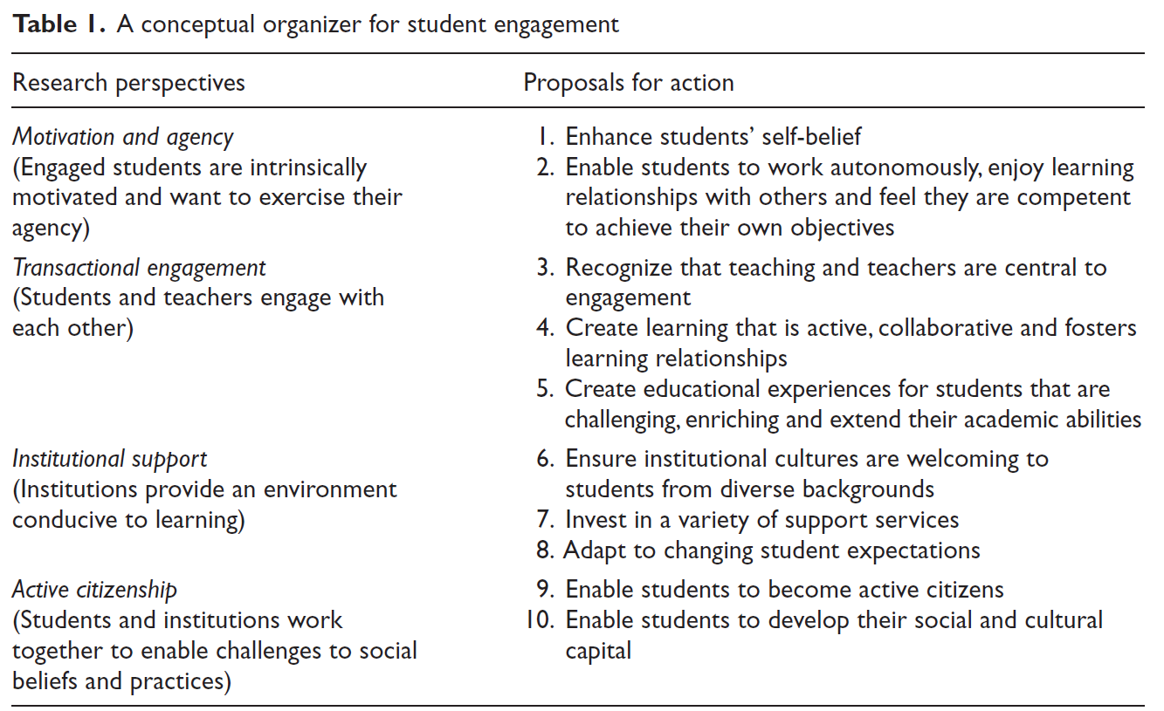
Notes:
2010 11: 169 Active Learning in Higher Education Nick Zepke and Linda Leach Improving student engagement: Ten proposals for action
NB 4 Create learning that is active, collaborative and fosters learning relationships

