Slide 1


ESD toolkit: Systems thinking template slides
These slides have been created to save you a little time if you want to incorporate systems thinking for sustainability into your teaching. Please refer to the Systems thinking: teaching resources DIY guide in the ESD toolkit.
Reuse, edit, add your own examples relevant to your subject discipline etc as appropriate to these slides to meet your requirements. Copyright free images & diagrams are used in the slides.
If you already teach systems thinking in your subject area and you have resources that you think will be useful to colleagues in other subject areas and are willing to share – please contact cie@liverpool.ac.uk

Slide 2
What is a system?
“A system is a set of things – people, cells, molecules or whatever interconnected in such a way that they produce their own patterns of behavior over time.”
Meadows, D.H. (2008) Thinking in systems : a primer

Slide 3


What is a system? - Examples
For example, a washing machine is composed of different components that function together. A toolbox is a collection of unrelated objects.

Slide 4
System Vs a collection of objects or functions
A system has purpose.
All parts of the system must be present for a system to carry out its purpose optimally.
The order in which the parts are arranged affects the performance of a system.
Systems attempt to maintain stability through feedback.
Introduction to Systems Thinking (The Systems Thinker.com)

Slide 5


Complex systems
“Complex systems have many components, with many interrelationships, whose combined effect is not easily seen or immediately predictable.”
Northrop, R.B. (2010) Introduction to complexity and complex systems

Slide 6
Simple, complicated & complex problems 1
Simple, complicated & complex problems
“Simple problems (such as following a recipe or protocol), may encompass some basic issues of technique and terminology, but once these are mastered, following the ‘recipe’ carries with it a very high assurance of success.”
Complicated or complex – knowing the difference is important – Learning for Sustainability.net

Slide 7
Simple, complicated & complex problems 2
Simple, complicated & complex problems
“Complicated problems (like sending a rocket to the moon), are different. Their complicated nature is often related not only to the scale of the problem, but also to their increased requirements around coordination or specialized expertise. However, rockets are similar to each other and because of this following one success there can be a relatively high degree of certainty of outcome repetition.
Complicated or complex – knowing the difference is important – Learning for Sustainability.net

Slide 8
Simple, complicated & complex systems
“Complex systems are based on relationships, and their properties of self-organisation, interconnections and evolution. Research into complex systems demonstrates that they cannot be understood solely by simple or complicated approaches to evidence, policy, planning and management.”
Complicated or complex – knowing the difference is important – Learning for Sustainability.net

Slide 9
Complex ‘wicked’ problems
“Wicked problems are highly complex and tend to be messy and difficult to define. Attempts to solve them usually involve multiple stakeholders with diverse and often contradictory perspectives, and such efforts can result in unforeseen outcomes, which may even make the problems worse.”
McCune, V., Tauritz, R., Boyd, S., Cross, A., Higgins, P., & Scoles, J. (2021). Teaching wicked problems in higher education: ways of thinking and practising.

Slide 10
Complex ‘wicked’ problems - Components
Complex ‘wicked’ problems tend to have three interrelated components:
Complexity – multiple elements, sub-systems (social, economic, environmental) and interdependencies.
Uncertainty – risks, consequences of actions, changing patterns.
Divergence – stakeholder values, viewpoints, strategic intentions.
Head, B.W. (2023). Wicked Problems in Public Policy
Notes:
Complex ‘wicked’ problems include issues such as climate change, inequality, health and social issues such as social care provision that are problematic for multiple reasons.
Give a few examples of complex ‘wicked’ problems that students in your subject area can relate to.

Slide 11
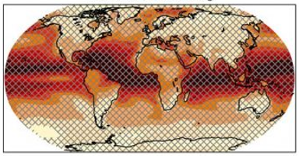
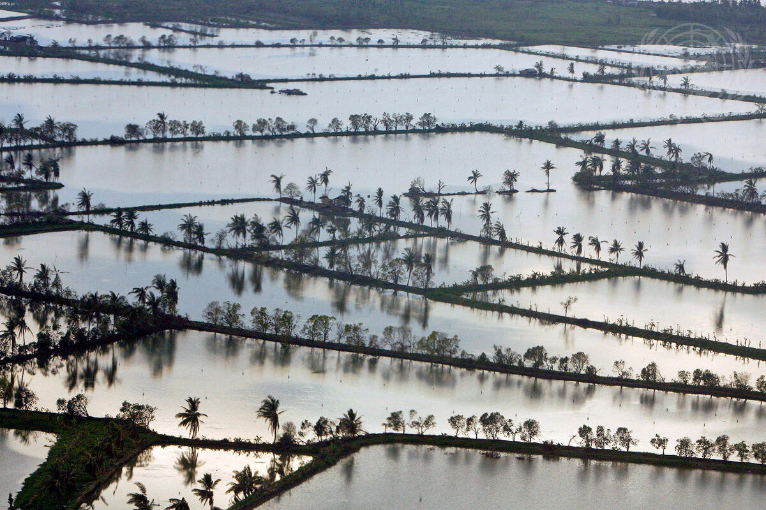
Sustainability & Systems Thinking
Many sustainability issues and challenges are composed of inter-related social, economic, and environmental systems e.g. climate change.

Slide 12

Complex ‘wicked’ sustainability problems
“Sustainability problems are stubborn, ‘wicked’ problems, distributed across complex interconnected systems, dynamic, ambiguous, unfamiliar, lacking definitive answers. They have multiple stakeholders who draw on different sources of information, making them prone to conflicts of interest.”
Gulikers, J. and Oonk, C. (2019) Towards a rubric for stimulating and valuating sustainable learning

Slide 13
Linear Vs interconnected circular relationships
Linear cause and effect relationships:
A
B
C
D
Interconnected circular relationships:
A
B
C
D
Introduction to Systems Thinking (The Systems Thinker.com)

Slide 14


The UN’s Sustainable Development Goals
Understanding the interrelationships between social, economic, and environmental components to any given sustainability problem

Slide 15
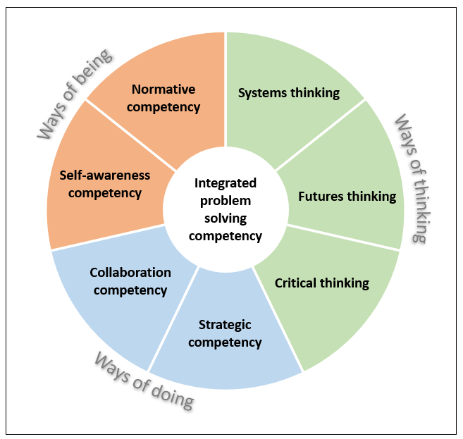
Competencies for Sustainability
Systems thinking competency: approaching problems that analyse how all the elements within a system influence one another.

Slide 16
Why systems thinking is important for sustainability
Change our thinking to match the interconnected, dynamic complexity of our communities and their environments.
Communicate with others to create new ways of thinking and seeing.
Change our behaviour to work with the complex forces in the system (instead of against them) to realise our vision.
Identify and test a wider variety of possible actions and solution pathways.
Become more aware of the potential for unintended consequences of our actions.
Harness social learning processes to help us develop a shared understanding and take action collectively.
Expand the choices available to us and identify those choices where we can develop significant leverage.

Slide 17
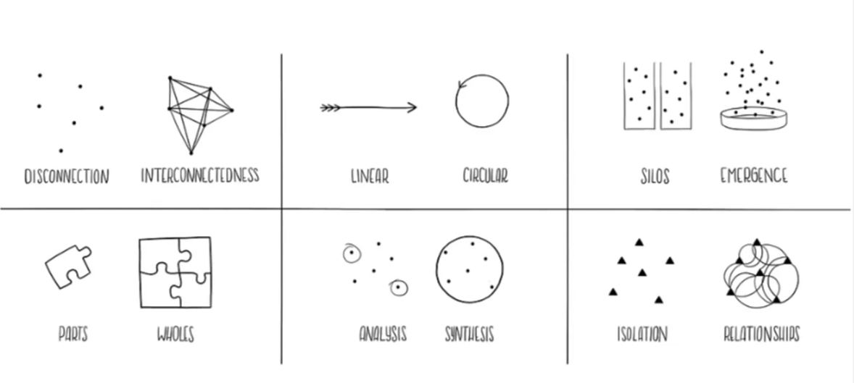
Tools of a systems thinker
Tools for systems thinkers: The 6 Fundamental Concepts of Systems Thinking Medium.com

Slide 18
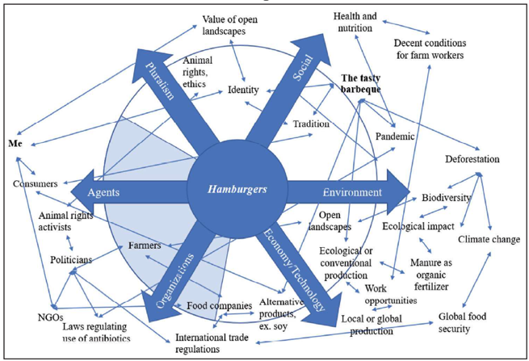
System thinking techniques: EPOSA
A simple paper-based graphic template designed to enable you to structure and explore your understanding of a complex issue.
EPOSA (environmental, pluralism, organisation, social, economy/ technology, agents)

Slide 19
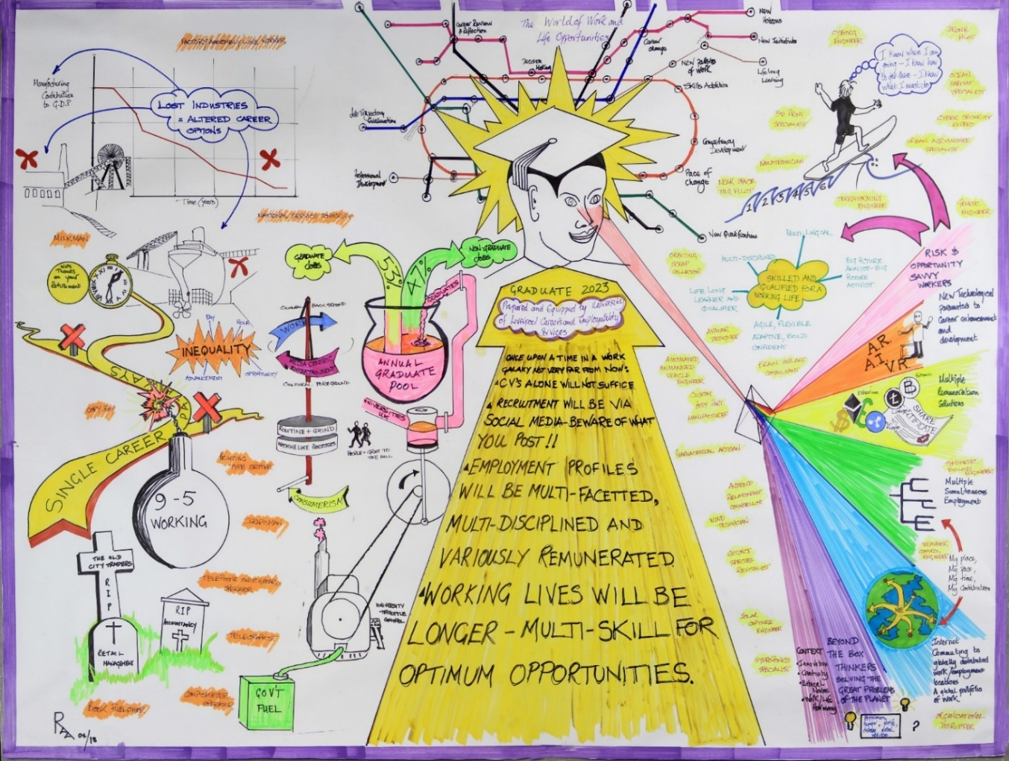
System thinking techniques: Rich Pictures
Gather in one place, on one sheet of paper, all the data about a complex messy situation that you have collected:
Rich pictures are situation summaries. They are an attempt to encapsulate the real situation through a no holds barred, cartoon representation of things that you perceive in the situation – objects, layout, connections, relationships, influences, cause and effect, structures, processes, issues, arguments, and so on.
Rich Pictures – The Open University

Slide 20
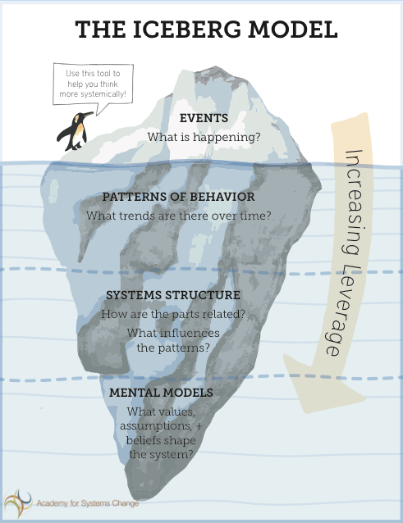
System thinking techniques: Iceberg model
Events: what’s happening?
Patterns & trends: what trends are there over time?
Systems structures & drivers: how are the parts related? What influences the patterns?
Mental models: what values, assumptions, beliefs shape the system?
Developed from: Systems Thinking Resources (The Donella Meadows Project)

Slide 21
System thinking techniques: Systems Maps
Thinking and communication tool to group systems and sub-systems:
Wider environment
of the system
that may influence it
Boundary of the system
Components
Sub-systems
grouped by purpose
Outside the system
not included
Systems Maps – The Open University

Slide 22
System thinking techniques: Spray Diagrams
Help structure information from multiple sources:
Causes
Sub-theme
Sub-branches
Influences
Sub-theme
Central theme
Links
Important cross
connections
Sub-theme
Arguments
being made
Spray diagrams – the Open University

Slide 23
System thinking techniques: Influence Diagrams
How significant individuals, groups, bodies, or other factors influence each other:
The nature of the relationship can be indicated by
line thickness, colour, labelling etc.
Groups
Legislation
Individuals
Culture
Salaries
Influence Diagrams – the Open University

Slide 24
System thinking techniques:
Multiple Cause Diagrams
Explore why something has happened or why it is a certain way:
Aims to identify possible points of intervention
& help communicate your understanding of a system
Cause A
A specific situation
Cause
Cause X
Cause B
Cause Y
Multiple Cause Diagrams – the Open University
Notes:
Add in your own examples relevant to your subject area to the diagram.

Slide 25
System thinking techniques:
Causal Loop Diagrams
Related to multiple cause diagrams and are used to graphically depict dynamic interrelationships among variables you may not have considered before:
Variable A
O – cause in opposite direction
S – cause in same direction
R – reinforcing
B – balancing
- time delays
=
S
O
S
B
Variable B
=
R
S
O
Variable C
Causal Loop Diagrams – the Open University
Notes:
Add in your own examples relevant to your subject area to the diagram.

