Slide 1


ESD toolkit: Futures thinking template slides
These slides have been created to save you a little time if you want to incorporate futures thinking for sustainability into your teaching. Please refer to the the Futures thinking for ESD: teaching resources DIY guide in the ESD toolkit.
Reuse, edit, add your own examples relevant to your subject discipline etc as appropriate to these slides to meet your requirements. Copyright free images & diagrams are used in the slides.
If you already teach futures thinking in your subject area and you have resources that you think will be useful to colleagues in other subject areas and are willing to share – please contact cie@liverpool.ac.uk

Slide 2
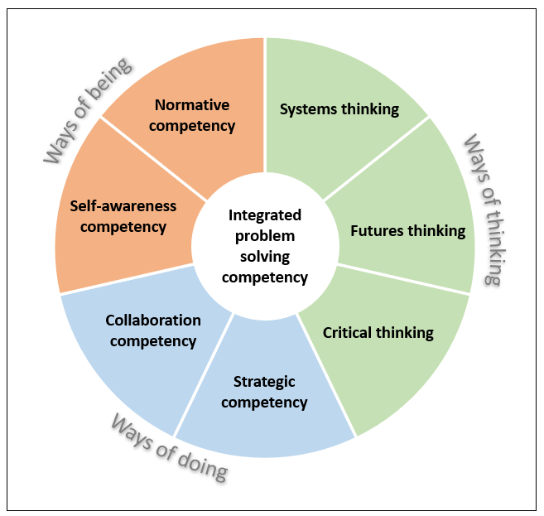
Sustainability competencies
Futures thinking competency

Slide 3
Futures thinking (anticipatory) competency
“The futures thinking (anticipatory) competence seeks to develop your ability to understand and evaluate multiple futures – possible, probable, desirable – and to create their own vision for the future.” “It seeks to ‘futureproof’ by helping to develop knowledge, skills, attributes and values that will enable you to think about consequences of actions and to contribute to a future in which systems and societies can be adaptive to ensure a sustainable future.”
Adapted from the QAA’s Education for Sustainable Development guidance

Slide 4
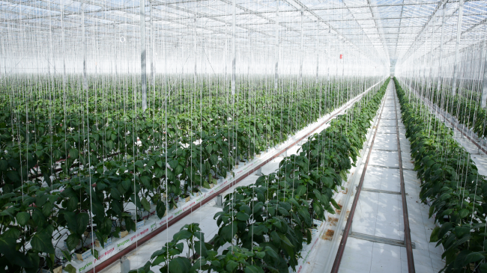
A greenhouse with rows of plants
Notes:
UN image relating the Sustainable Development Goals (SDGs)

Slide 5
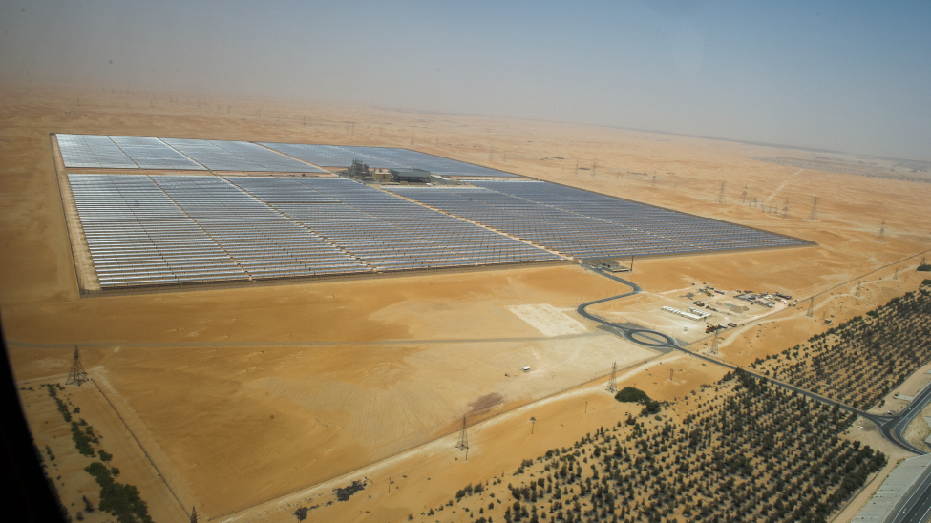
Solar panels in a desert
Notes:
UN image relating the Sustainable Development Goals (SDGs)

Slide 6
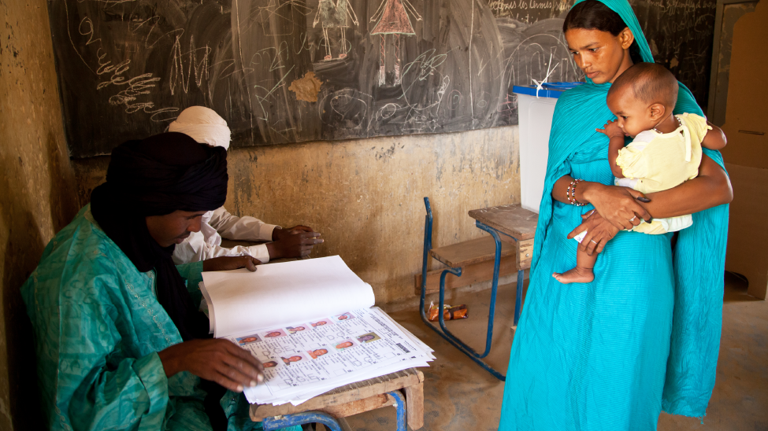
A woman holding a baby looking at a man reading some documents at a small desk.
Notes:
UN image relating the Sustainable Development Goals (SDGs)

Slide 7
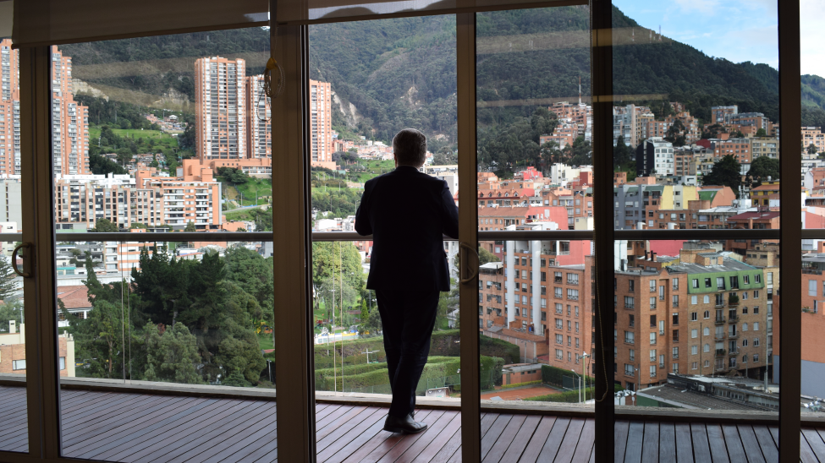
A person standing at a balcony looking out to a city.
Notes:
UN image relating the Sustainable Development Goals (SDGs)

Slide 8
Where do you stand game
Things are good and getting better. We have to work with larger forces and play our part
Things are getting better; AND we can act to make things even better
Things are getting worse; There is nothing I can do about it. I cannot make things worse so I am free of the responsibility of trying to do that
Things are getting worse generally; But I can act to make a difference here and now, in this place. It may not change the futures but it is still worthwhile
Hayward P., Candy C. (2017), The Polak Game, Or: Where Do You Stand?
Notes:
Insert your own information into each quadrant etc. You can use a polling tool in the classroom to canvas students views on a given issue or problem area.

Slide 9


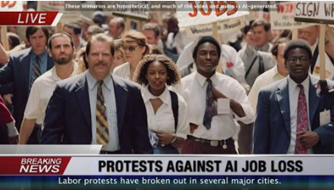

Future headlines
Describe a future scenario as a social media or legacy media headline
Notes:
Edit images as appropriate or add something relevant to your subject area.

Slide 10


Day in the life of
Describe how a particular persona goes about their typical day in the future - why this might happen or what might happen differently.

Slide 11
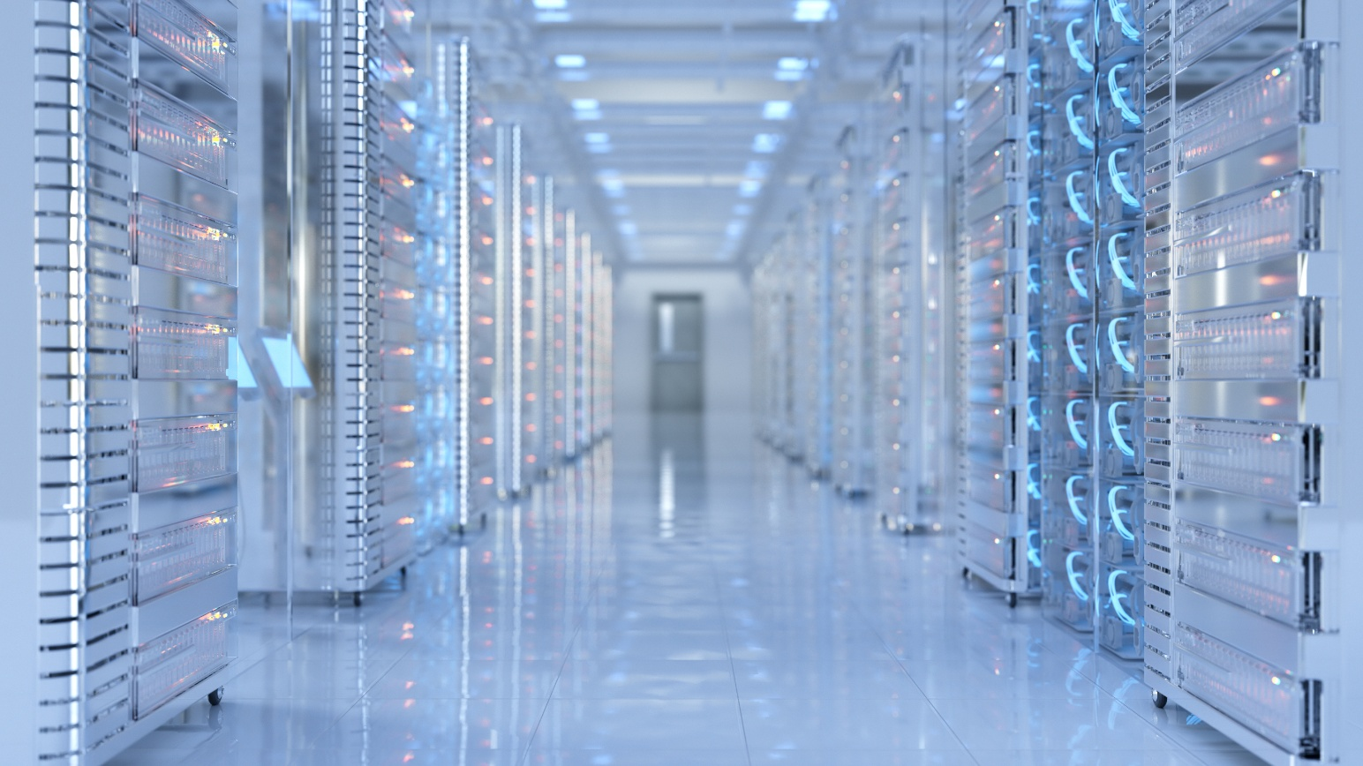
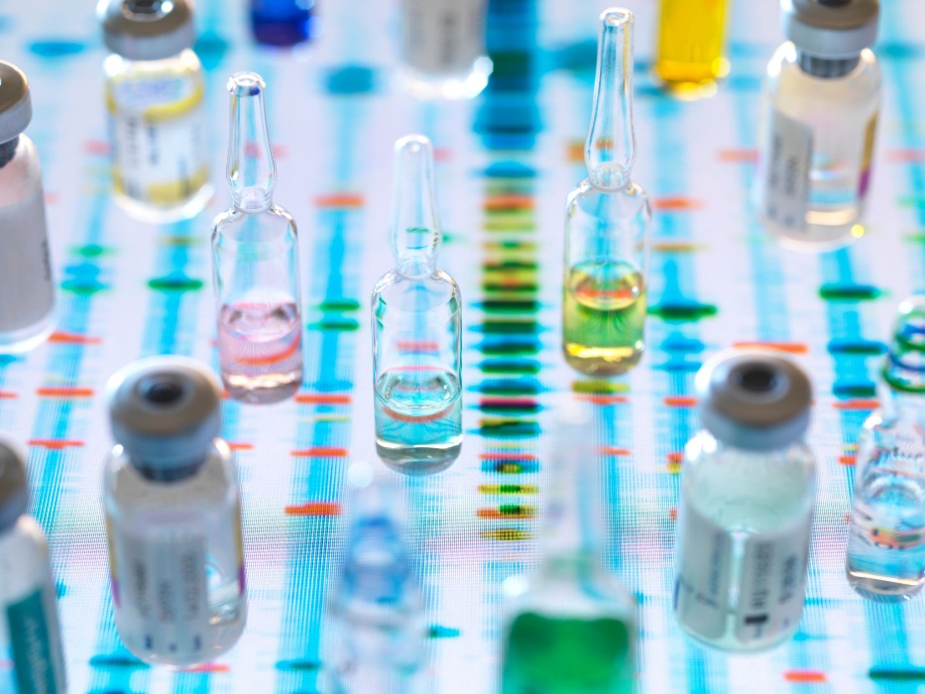
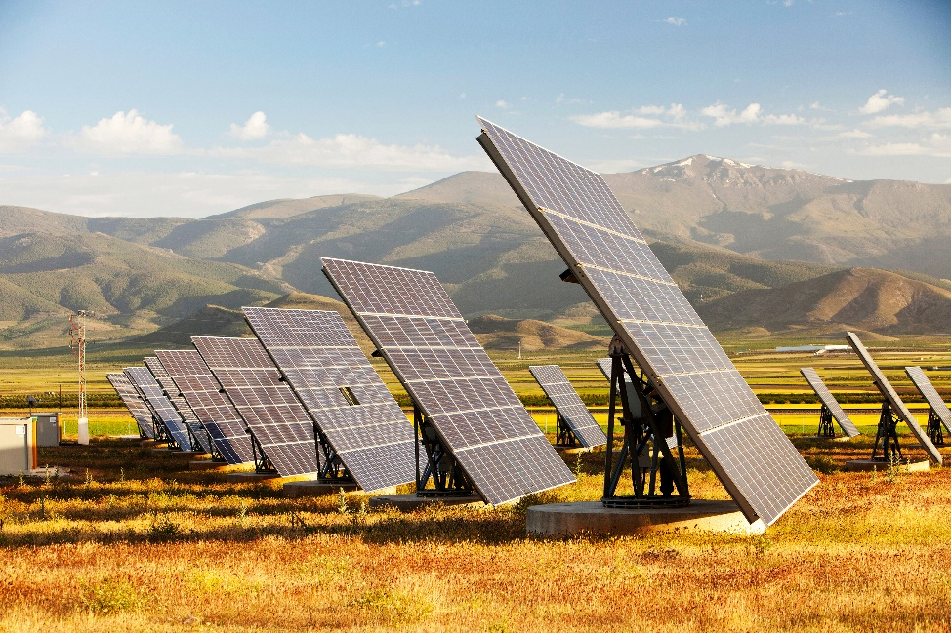
Future artifact
‘Be’ in the future by experiencing what it would feel like.

Slide 12
Advice from the future
‘Be’ in the future by experiencing what it would feel like.

Slide 13
Forecasting Vs Foresight
Forecasting | Foresight
The way history and current events might develop in the future. Looking ‘forward’ to the future from the present. | Evolution of change and the response of the organisation to ‘incoming’ change from the outside world.
Foresight manual empowered futures for the 2030 agenda

Slide 14
Forecasting Vs Foresight - continued
Forecasting | Foresight
Less complex more predictable contexts | Complex uncertain contexts
The future is singular | The future is plural
Focuses on the most likely future | Sets of possible futures - possible, plausible, probable
Since we do not know future disruptions we cannot include them in any evidence-based process | Since we do not know which disruptions will occur, we must include plausible hypothetical disruptions to prepare for those that do occur
Following through on plans, predictive | Flexible, adaptable, exploratory, experimental
Experts in a given field | Broader set of stakeholders

Slide 15
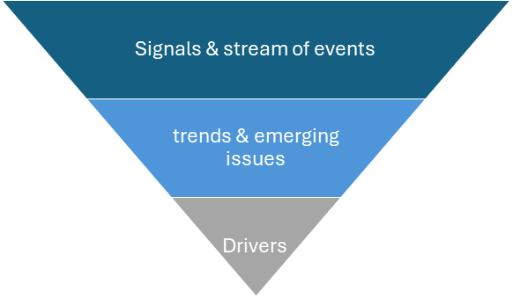
Foresight: Horizon Scanning
Explore future possibilities, looking out for ‘weak signals’

Slide 16
Foresight: Horizon scanning - continued
Focus on uncertainties – ‘wild cards’
Black swans – low probability high impact events.
Grey swans – predictable to a certain extent e.g. earthquakes.
Dirty white swans – surprising only due to cognitive bias.
Red swans – in reality not that impactful.
Red herrings – misleading or fake signal.
Dragon king – large extreme events that do not really come out of nowhere e.g. 2008 financial crash.
White elephant – everybody is aware of it, but nobody wants to recognise its presence or relevance.

Slide 17
Foresight: Scenarios
Possible pathways from the present to the future:
Preferable – want or should happen.
Probable – likely to happen.
The ‘projected’ future – business as usual.
Plausible – could happen.
Possible – might happen.
Preposterous – won’t ever happen!

Slide 18
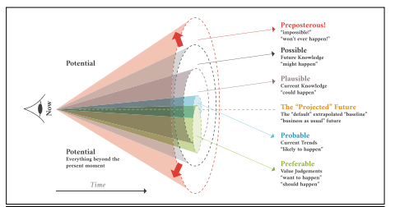
Foresight: Futures cone

Slide 19
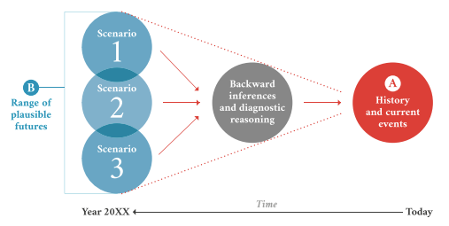
Foresight: Backcasting
Work backwards to identify major events, data points, and signals that will generate the future scenario to outline a potential trajectory ‘how it might happen.’

Slide 20
Foresight: linking scenarios to strategy
Scenarios | Policy/ strategy considerations
Preferable Scenario name:
Probable Scenario name:
The ‘projected’ future Scenario name:
Plausible Scenario name:
Possible Scenario name:
Preposterous Scenario name:
Connecting future scenarios to actions and plans: policy and strategy

Slide 21
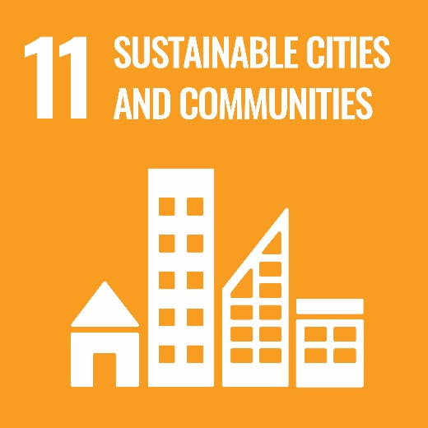
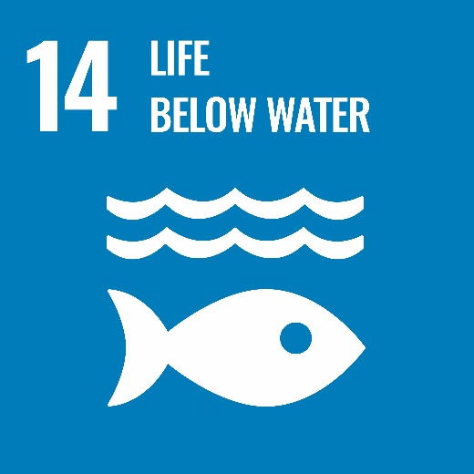
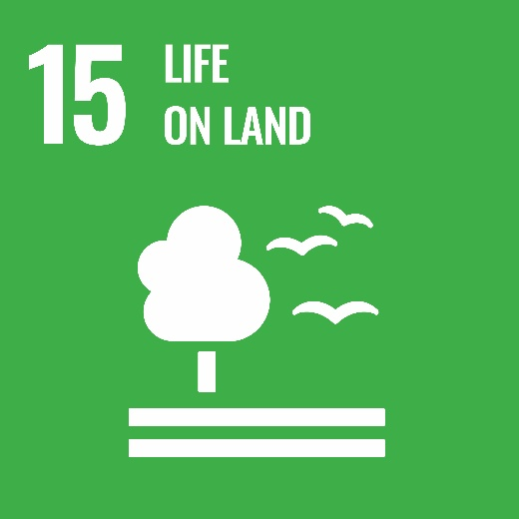
Foresight: Precautionary principle
“When human activities may lead to morally unacceptable harm that is scientifically plausible but uncertain, actions shall be taken to avoid or diminish that harm.
Morally unacceptable harm refers to harm to humans or the environment that is threatening to human life or health, or serious and effectively irreversible, or inequitable to present or future generations, or imposed without adequate consideration of the human rights of those affected.
The judgement of plausibility should be grounded in scientific analysis. “
UNESCO precautionary principle

