Slide 1
Digital fluency:
a graduate attribute from
our Liverpool Curriculum Framework
Dr Kate Evans
Tünde Varga-Atkins

Slide 2
Session Outcomes
Express the purpose and nature of digital fluency and be able to translate its significance for course design to your respective educational disciplinary contexts.
Communicate the significance of digital fluency as a course design principle to peers within your subject area.
Critically evaluate, select and apply appropriate forms of digital fluency to your current programme and/or module.

Slide 3
Outline
What is Digital Fluency?
  JISC’s Digital Capability Framework
  Some practical ideas & examples
Developing DF: programme & module outcomes (skills)
  Disciplinary digital capabilities
  Enhancing students’ digital fluency
  Considerations

Slide 4
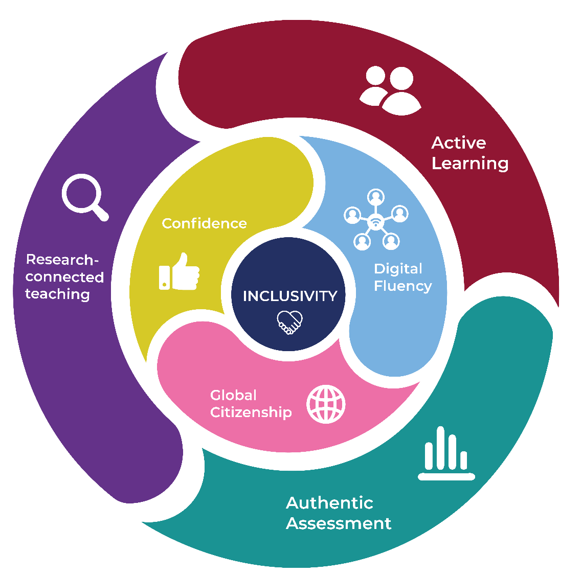
Liverpool Curriculum Framework Hallmarks & Attributes

Slide 5
Liverpool Curriculum Framework Principles
All programmes are based on the core value of inclusivity which is embedded in the curriculum, meaning “An inclusive curriculum is universal and intended to improve the experience, skills and attainment of all students including those in protected characteristic groups.”
All students undertake a capstone research- or enquiry-based project, which may be synoptic (allowing them to draw on a wide range of elements from the modules they have taken).
All programmes include applied enquiry-led learning in at least one required module each year (UG only).
The use of authentic assessment is built up progressively and maximised across all programmes.
Formative assessment and feedback/ feedforward are used to engage students in active learning in all modules.
Students’ digital skills are developed progressively.
All students are provided with opportunities to undertake work placement and/or experience a period of study abroad.

Slide 6
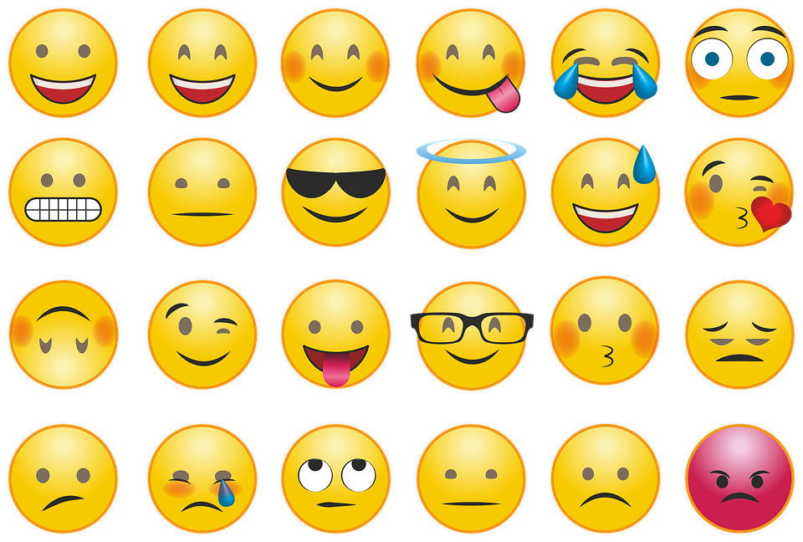
Your feelings about technology

Slide 7
Digital fluency
Digitally fluent graduates think critically
about the information they find, use and generate, developing their ability to use digital platforms to problem-solve, create,
collaborate, and communicate.

Slide 8

Digital fluency (skills < capabilities)
What does it mean
in your subject / programme / module?
cc: Jirka Matousek - https://www.flickr.com/photos/28415633@N00

Slide 9
First things first: your graduates’ attributes
Subject/programme:
Module:
My field of expertise in a tweet
A successful X in my area is:

Slide 10
Defining a digitally fluent professional in X
To what extent is digital fluency currently embedded in my/ discipline teaching?
How are digital skills/capabilities designed in learning (& skill) outcomes, via learning & teaching and assessment methods?
Consider your
QAA subject benchmarks,
professional body requirements,
programme and module specifications

Slide 11

Activity: Digital fluency: 6 capabilities
Using the radar diagram,
think-pair-share
Consider your programme/module – where are the digital capabilities currently taught, practised or assessed?
Photo by Marc Wathieu - Creative Commons Attribution-NonCommercial License https://www.flickr.com/photos/88133570@N00

Slide 12
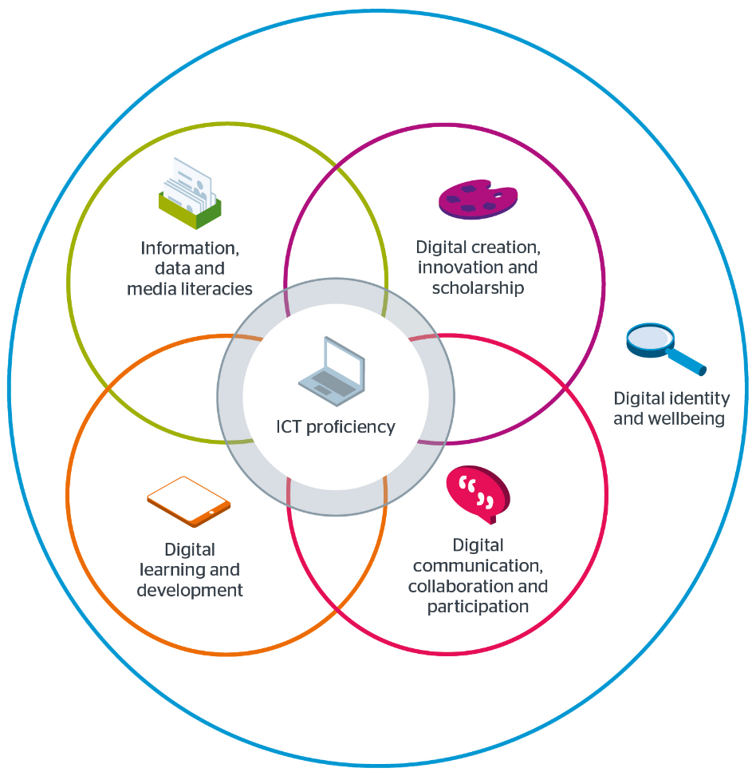
Digital Capability Framework
(JISC 2017)
Notes:
Change image to transparent

Slide 13
Digital Fluency in programme / module
Programme / module title:
My field of expertise in a tweet
A successful X in my area is:
A digitally fluent X is:
Adapted from JISC & ABC Learning Design

Slide 14
Digital Capability Framework
(JISC 2017)
Digitally fluent graduates are able to think critically and make balanced judgements about the information they find and use.
2. Information, data- and media literacy
Also: media literacy = the capacity to critically receive and respond to messages in a range of digital media

Slide 15
Example tasks for info, data & media literacy
finding and critically evaluating a range of digital media, e.g. text, image, video, animation or audio.
consulting and critically evaluating a range of academic, professional & industry sources and databases.
manipulating, analysing and presenting numerical, visual and textual data.
organising and sharing digital data/information/media created by others ethically, legally and safely.

Slide 16
Digital Capability Framework
(JISC 2017)
Whilst maintaining a critical perspective, digitally fluent graduates are open to continuously developing digital practices and artefacts in their specialist subject areas and in organisational settings.
3. Digital creation, innovation and scholarship
also ‘digital problem-solving’

Slide 17
Example tasks for digital problem-solving
Challenging students to discover, develop and share (new) ideas and research data using digital tools.
Using modelling tools, simulation, VR/AR, virtual field trips, online role-play and games.
Producing digital artefacts, performances, presentations, representations of designs, (multimedia) digital resources, social media contributions etc.
Using online data sets, digital tools for manipulating data in new ways.

Slide 18
Digital Capability Framework
(JISC 2017)
Students are able to effectively utilise digital platforms to connect, collaborate, and communicate in academic and professional contexts and as citizens.
4. Digital collaboration, comm & participation

Slide 19
Some tasks for digital collab/comm
presenting findings in a range of digital formats, appropriate for a defined audience or purpose (report, social media post, video, etc.)
problem-solving individually or collaboratively using digital technologies (disciplinary software, wikis, forums, distant debates etc.)
participating in digital (professional) networks safely, ethically and with respect (online discussions, email, forums, web-conferencing (sync/async), mailing lists, social media etc.)

Slide 20
Digital Capability Framework
(JISC 2017)
Students skilfully manage their digital identity across multiple platforms in a professional and responsible manner.
Digital identity and wellbeing
Digital
problem-solving
Info-/data- and media literacy
ICT proficiency
Digital
learning and development
Digital collaboration / communication

Slide 21
Some ideas for digital identity & wellbeing
Evaluate own and peers’ online identities and academics/professionals in your subject.
Creating/developing a professional online identity in the context of disciplinary tasks, e.g. blogs/wikis.
Following your field’s developments or subject experts online and on social media.
Creating tips for developing a positive online identity.
Debating cultural and institutional norms of digital behaviours, work-life balance & online safety in relation to your subject.

Slide 22
Digital Capability Framework
(JISC 2017)
The capacity to participate in and benefit from digital learning opportunities;
The capacity to support and develop others in digitally-rich settings. (JISC 2017)
Digital learning and development

Slide 23
Some ideas for digital learning/dev
using institutional platforms, e.g. VLE, resources, online submission, online tutorials
signposting students to applications that help organise and plan work (e.g. productivity, mind-mapping tools, revision apps/tools).
signposting students to digital learning opportunities (e.g. Lynda.com, YouTube, MOOCs, blogs, online help/tutorials, study skill sites etc.)
recording learning or achievement (e.g. online portfolios, reflective logs, etc.).

Slide 24
Digital Capability Framework
(JISC 2017)
The confident adoption of new devices, applications, software and services and the capacity to stay up to date with ICT as it evolves.
The capacity to deal with problems and failures of ICT when they occur and implement solutions.
An understanding of basic concepts in computing, coding, and information processing.
ICT proficiency

Slide 25
Some ideas for ICT proficiency
Get students to critically reflect on and evaluate their use of technologies and resources in specific tasks.
Bartering useful apps between students – last useful app/technology learnt.
Discussing troubleshooting IT challenges.
Setting coding challenges for the more advanced.
Peer-led teaching: senior peers support students with technologies/applications.

Slide 26
Digital Fluency in programme / module
Programme / module title:
My field of expertise in a tweet
A successful X in my area is:
A digitally fluent X is:
Adapted from JISC & ABC Learning Design
Notes:
Hand out handouts

Slide 27
How could I adapt my module design to enhance students’ digital fluency?
Consider – module-level:

Slide 28
How can you develop students’ digital fluency progressively across your programme?
[Liverpool Curriculum Framework principle]
What are the challenges of doing this from a programme design perspective?
Consider: programme-level

Slide 29
Possible perspectives on progression 1
Independence, synthesis
& critical judgement
e.g. locating, choosing, using digital resources or digital tools, information, data

Slide 30
Possible perspectives on progression 2
use
evaluation
production / creation
critical
critical
critical
digital resources, digital tools and technologies, digital artefacts

Slide 31





Possible perspectives on progression 3
public-facing outputs e.g.
University’s ‘walled garden’,
e.g. VLE

Slide 32
One challenge:
How can students recognise the (critical) digital skills/capabilities that they are developing?

Slide 33
Layers of criticality in using digital technologies and sources
Critique of outcomes/product
Choice: which digital tool/resource?
Digital or not?
Process: which way?
How/Can we tell it is right/wrong?
Are there different ways of achieving the same result or outcome?
Do we exclude/include anyone? Professional / ethical considerations, bias etc.
Advantages/Dis~ of using digital tool

Slide 34
Activity: Pick one ‘signature’ capability
Consider how one skill / attribute might look for your graduate – and how you could progressively support its development (and evidence of) in your programme?
Photo by Marc Wathieu - Creative Commons Attribution-NonCommercial License https://www.flickr.com/photos/88133570@N00

Slide 35
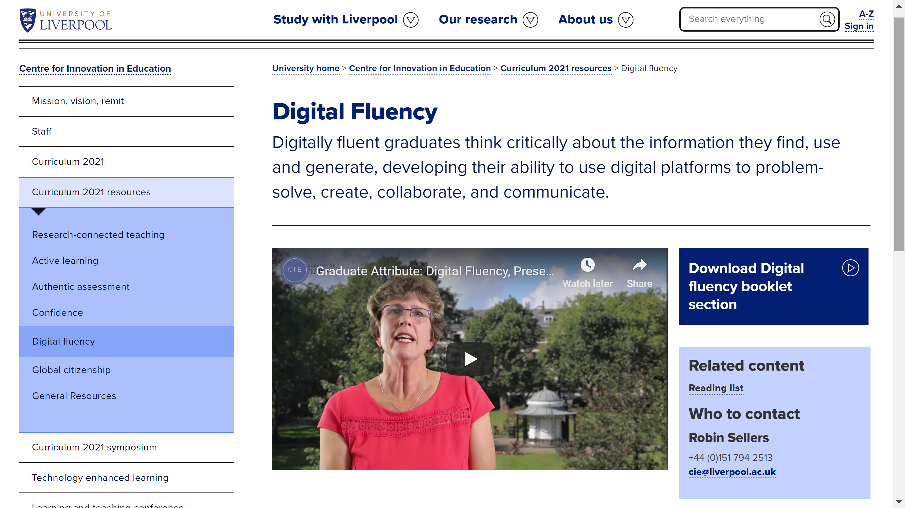
Liverpool Curriculum Framework resources on DF online

Slide 37
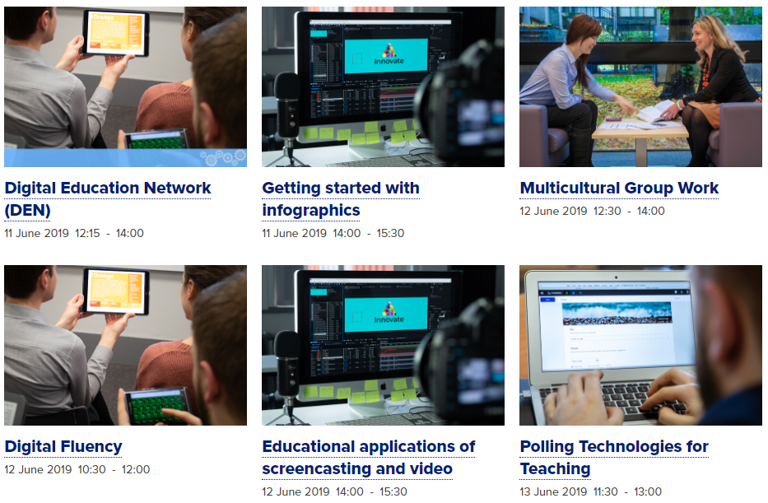
Upcoming Workshops
Centre for Innovation in Education upcoming workshops

