Slide 1
From chatbot to colleague:
Evolution of AI in sustainable learning support
Dr. Etieno Enang
University of Liverpool Management School
Rob Lindsay & Will Moindrot
Centre for Innovation in Education
Notes:
https://canvas.liverpool.ac.uk/courses/77602
https://chatgpt.com/gpts

Slide 2
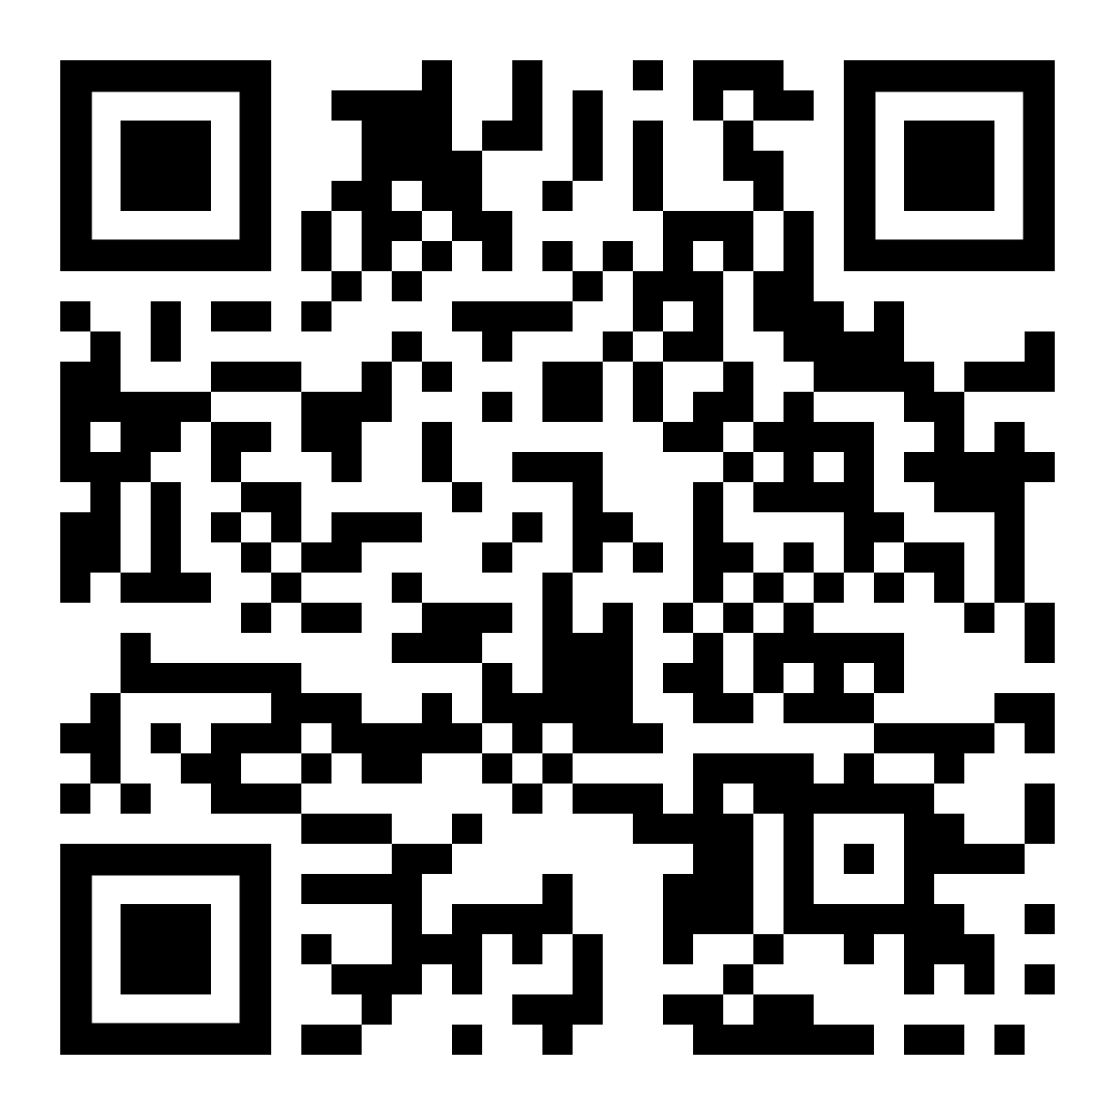
Disclaimer
The climate and sustainability implications of generative AI
Bashir et al. (2024).
Critiques the narrow focus on efficiency improvements and calls for a broader benefit–cost evaluation framework involving environmental, economic, and social metrics.

Slide 3


Context
“I’m leading a large year 3 module with almost 550 students. I’m also delivering all the lecturers and seminars on this module. Do you currently have any ideas on innovative teaching and seminar techniques for large cohorts. This module has the tendency to impact our NSS results - being a final year module, any suggestions and advice will be helpful.”
Dr Etieno Enang
Lecturer in International Business and Strategy
August 2024
Notes:
Increased move towards less modules but ever larger cohorts
Need for connection by students
Questionable scalability of current practices
Vicious circle – due to the high student to staff ratios, students needing personal time to connect with staff, but staff having less time to be able to do this

Slide 4
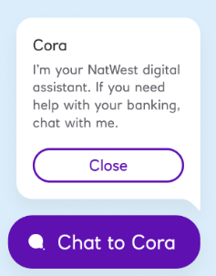
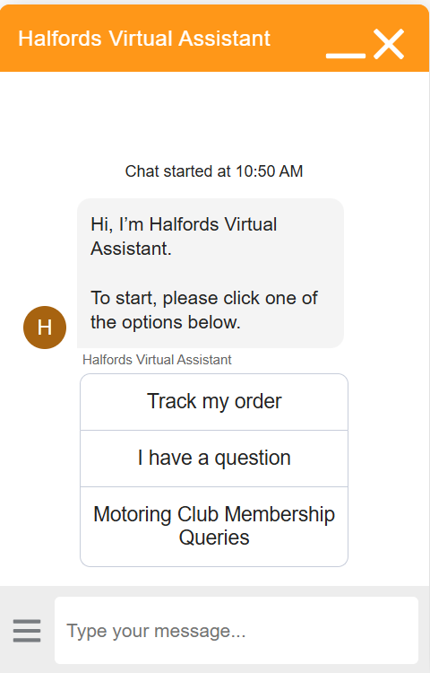
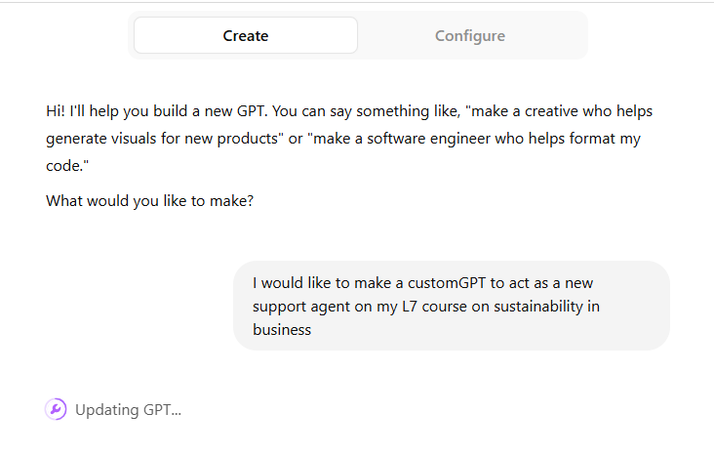
What is a chatbot?

Slide 5
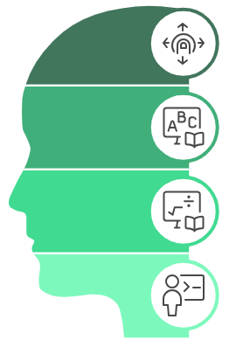
GenAI and EDI
Enhancing sensory access
Supporting cognitive and language diversity
Reducing educator workload
Personalising learning

Slide 6
Trialling Custom-GPTs within teaching
Case | Module | Chatbot Design | Student Support | Uptake
Case 1 Initial implementation | 457 students Final year | Generic persona Answering course queries Trained on module and assessment information. | Canvas launch page & guidance In-class introduction | 264 chats (0.58 queries per student) Initial spike then decline
Case 2 Refined implementation | 265 students 2nd year elective | Custom persona. Devised to respond to specific group task questions. Training on course content | Canvas launch page & guidance In-class introduction Mid-term ‘checkpoint’: interactive workshop / AI literacy | 245 queries (0.92 queries per student) Steady usage, students returning for multiple queries

Slide 7
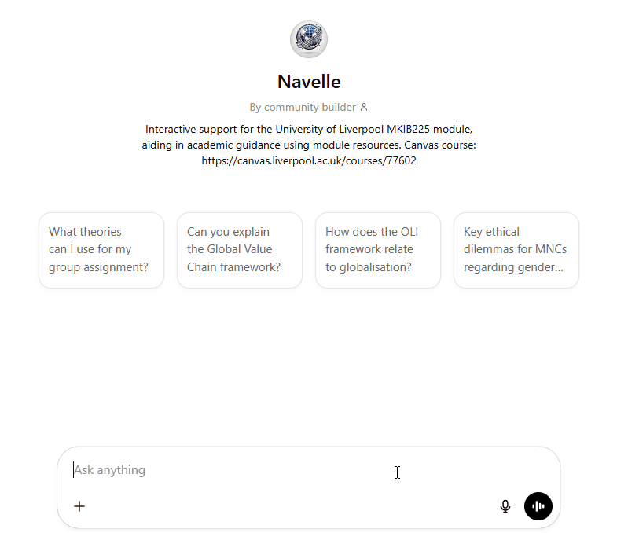
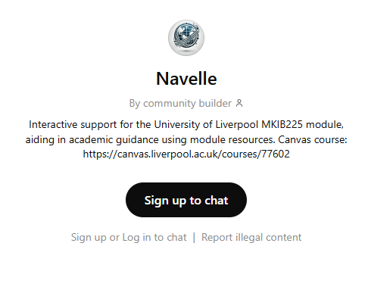
‘Navelle’
Notes:
“Navelle provides academic support and guidance to students in their group assignment. Navelle maintains a professional and friendly tone, fostering an engaging learning environment. Navelle does not provide answers to assessments but helps students understand concepts, improve their research skills, and develop critical thinking. If students require further clarification beyond Navelle's support, they should be referred to their instructor or relevant academic resources.”

Slide 8
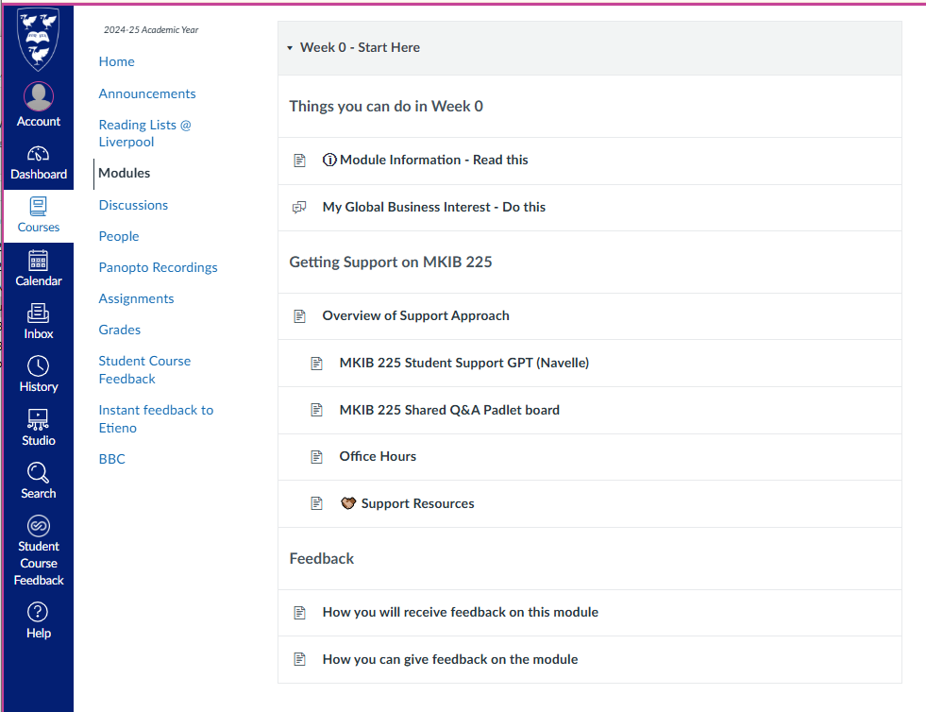
Integration
Embedded within existing support processes
Not a replacement
Optional
Transparent

Slide 9
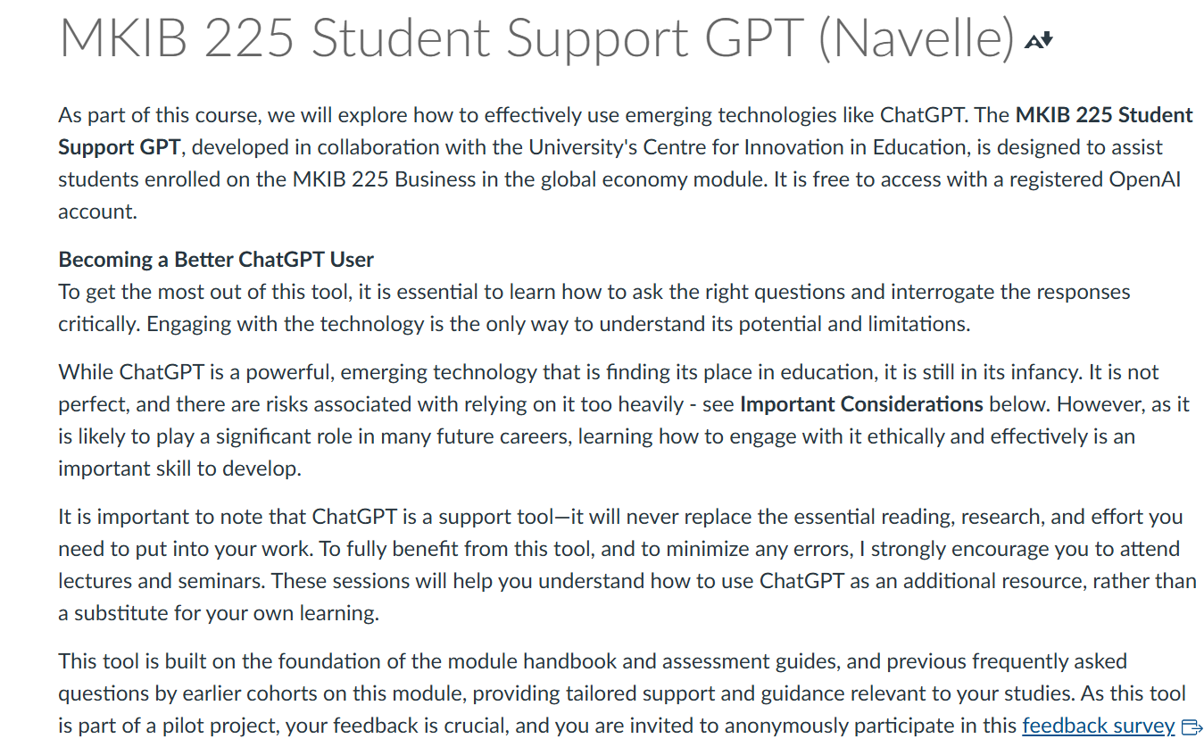
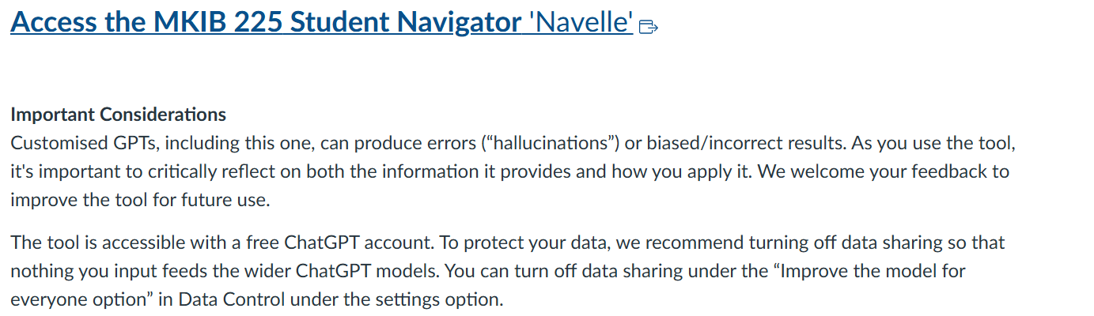
Guidance
Includes
Data privacy
Access
AI literacy
Accuracy

Slide 10
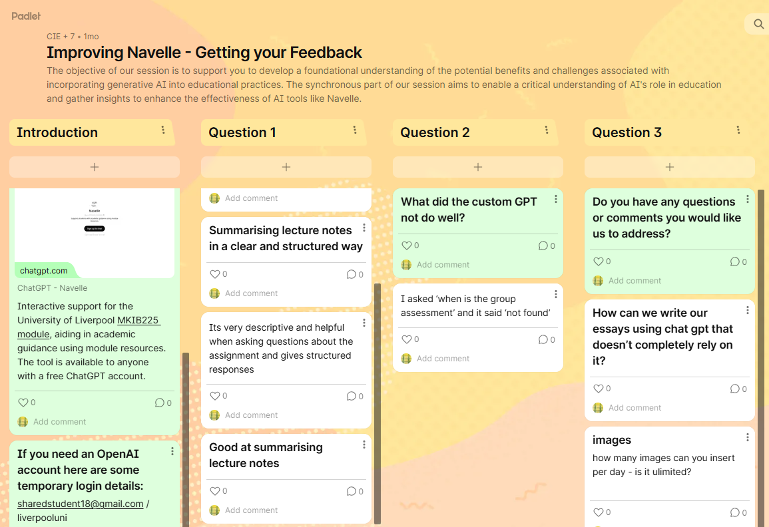
Co-creation
Interactive workshops
Improving Navelle
AI Literacy
Discussion of ethics
Effective use of GenAI

Slide 11
Desired features
Canvas integration
Easier access accounts
Automatic content training
More custom options for chatbot
Control external sources
Automatic escalation
Mobile!
Better analytics and data
School templates
Persistent chat
Lecture capture integration
Suggested Activities

Slide 12
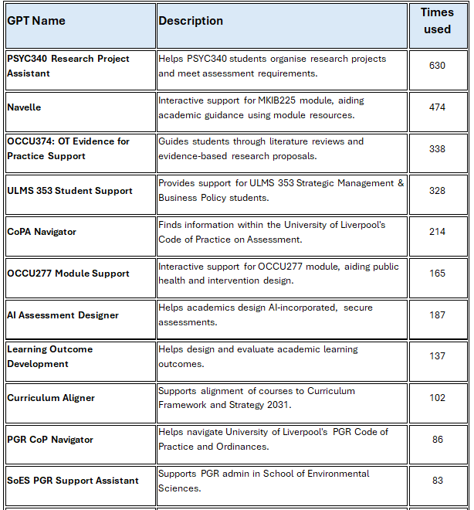
Other use cases
Next steps
Pilot commercial platforms
Embed within Canvas
Shareable resources
Institutional support

Slide 13

Sustainable?
Scalable
Inclusive
Environmentally aware
Ethical and transparent
Integrated long-term
Notes:
📈 Scalable – AI handles routine student queries across large cohorts (e.g., 550+ students), freeing up staff for high-value interactions.
🤝 Inclusive – Co-created content and AI literacy workshops ensure accessibility and relevance for all learners.
🌿 Environmentally Aware – Use energy-efficient models and promote smart, purposeful AI use.
🔐 Ethical & Transparent – AI embedded in Canvas with opt-in guidance; students know when and how AI is used.
🔄 Integrated & Long-Term – Seamless Canvas integration avoids tool duplication and ensures support evolves with institutional systems.

Slide 14
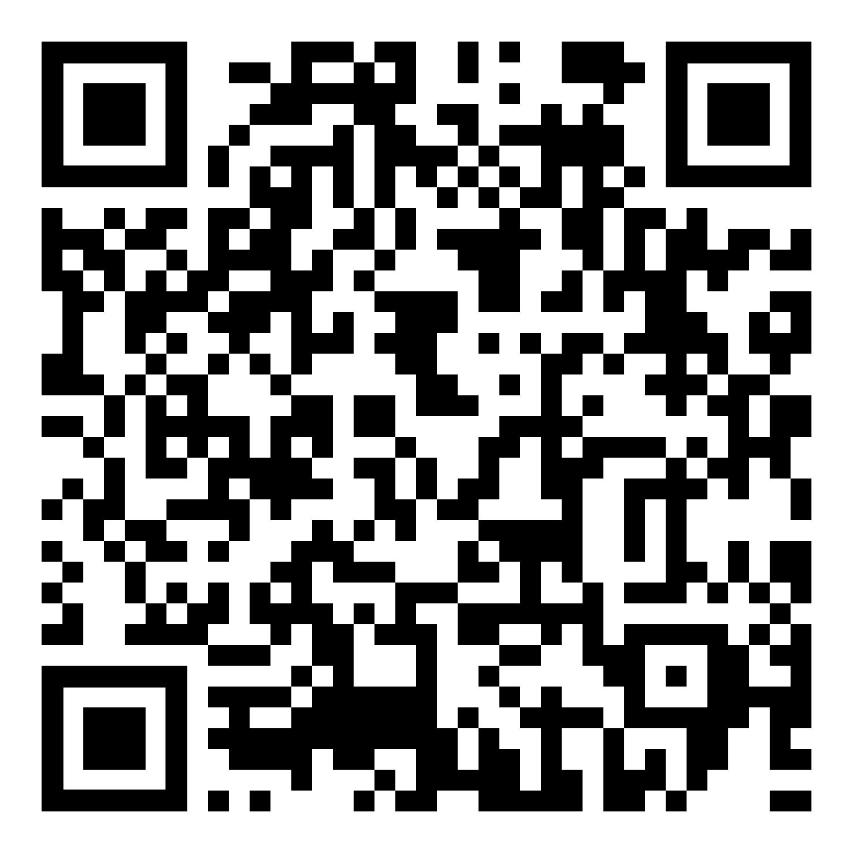
Thank you
Etieno.Enang@liverpool.ac.uk
Try Navelle
Notes:
Navelle link: https://chatgpt.com/g/g-678e71fb39448191bb489c8dffd3b4ba-navelle

